Slide 1
The One Guide for
Virtual Cards Generalists​
Notes:
Hello and thanks for being here.
Today, I wanted to explain more about SAP-embedded virtual cards, including how issuers and customer-facing teams can showcase the benefits.

Slide 2

Here’s What We’ll Cover
Get a clear understanding
Showcase
the value
Identify the right corporates
Understand
your role
Notes:
When organizations make business payments, they increasingly want things to feel fast, frictionless, and secure — with complete visibility at every stage. SAP-embedded virtual cards delivers that experience, and today’s presentation will help you:
Get a clear understanding of embedded virtual cards through SAP
Showcase its unique value to corporates
Identify which corporates are most likely to benefit from virtual cards
Understand your role in the virtual card process (and when to bring in a specialist)

Slide 3

Introducing SAP-Embedded Virtual Cards
Quick 20-Second Explainer
Notes:
Let’s start with a quick, high-level explanation of
SAP’s embedded virtual cards capability is built to automate payments at scale and deliver value throughout the procure-to-pay process.
It gives corporates a fast, secure, seamless way to manage B2B payments, right inside the SAP systems they already use to run their business.

Slide 4
The Big Benefits
to Corporates
1
Reduce
manual effort
2
Minimize
fraud risk
3
Speed up payments to suppliers
4
Lower
IT costs
Notes:
With embedded virtual cards through SAP,, corporates experience one seamless payment experience, all in one place. There’s no extra platforms and no need for workarounds — everything happens within their existing ERP and procurement workflows.
With that in mind, let me explain four of the other big benefits.
<Presenter prompt: Click to separately reveal the 4x on-screen benefits>
#1 Reduce manual effort: Every step of the virtual card payment process is automated, minimizing manual effort, reducing human error, and eliminating fragmented processes.
#2 Minimize fraud risk: Virtual cards are generated for specific transactions and enable strict spend control, helping substantially reduce the risk of fraud.
#3 Speed up payments to suppliers: Transactions via virtual cards typically just take just two days to reach a supplier’s account. Far quicker than traditional payment methods.
#4 Lower IT costs: Plug-and-play issuing removes the need for complex bank integrations, which can save organizations $100K–$300K in IT costs.¹

Slide 5



One Powerful Capability.
Two Effortless Ways to Pay.
Pay on Invoice
(SAP Taulia ERP-Embedded Virtual Cards)
Pay on PO
(Embedded Virtual Cards in SAP Ariba Buying)
Notes:
SAP’s embedded virtual cards offers two different ways to deliver payments: Pay on Invoice and Pay on PO. That means corporates can match the right virtual card flow to their payment needs. So, what do you need to know about these different payment models?
Let’s start with Pay on Invoice. This model automates virtual card issuance at the invoice approval stage.
It’s ideal for high-volume, ERP-integrated supplier payments
It works seamlessly within SAP S/4HANA, SAP ECC, and the SAP Business Network
It helps corporates eliminate manual processing and streamline reconciliation
And Issuers can position virtual cards as a scalable solution that delivers touchless automation and deeper ERP alignment
Now let’s look at Pay on PO. This model supports ad-hoc or urgent purchases by embedding virtual cards at the requisition stage.
It’s ideal for paying one-time suppliers or non-catalog spend
It works seamlessly within SAP Ariba
It helps corporates struggling with onboarding delays or manual workarounds for ad-hoc vendors
And issuers can position embedded virtual cards as a scalable solution that delivers flexibility without compromising procurement control

Slide 6




The Role of Issuers
in the Virtual Cards Process
Key issuer responsibilities:
Identify the
right prospects
Handle general inquiries
Flag upsell opportunities
Evaluate the customer
Notes:
Issuers are the first point of contact for corporates. They play a leading role in early education, commercial setup, and virtual card provisioning. As such, their relationship with the corporate is key to uncovering opportunities, driving adoption, and managing any financial or credit-related setup.
Let’s take a quick look at the issuer’s key responsibilities.
<Presenter prompt: Click to reveal the 4x on-screen headlines all at once>
Identify prospects that might be a good fit for virtual cards
Handle general customer inquiries and provide relevant FAQs and documentation
Flag upsell opportunities and coordinate with SAP Taulia for follow-up
Evaluate the customer and establish a new line of credit for virtual card use

Slide 7




Spotting Sales Opportunities
Ideal Customer Profile:
Already invested in SAP
Keen to use solutions inside their SAP systems
Ready for embedded virtual cards
Seeking flexibility
Notes:
SAP’s embedded virtual cards are built for the scale and complexity of large, SAP-run enterprises. Consider the following when you’re looking for potential new customers.
So the best-fit prospects are:
<Presenter prompt: Click to reveal the 4x on-screen headlines all at once>
Already invested in SAP and actively looking for smarter, more efficient ways to pay suppliers
Keen to use solutions that live inside their SAP systems
Ready for embedded virtual cards and looking to act when the right solution is presented
Seeking the flexibility to support a range of spend types, from high-volume invoice payments to urgent one-off purchases
And one extra tip for issuers: Aim to identify best-fit accounts as early as possible. It’ll help you focus resources where they’ll have the most impact, driving faster adoption and stronger revenue outcomes.

Slide 8

Spotting Sales Opportunities
Use Case #1
Full Automation Inside
SAP ERP
Use Case #2
Fast, Compliant Payments to Ad-hoc Suppliers
Notes:
Different corporates adopt virtual cards for different reasons, so an initial discovery call is crucial to understanding their needs. But before that happens, there are certain uses cases to look out for.
The first use case I’d like to walk you through is full automation inside SAP ERP.
<Presenter prompt: Click to reveal on-screen text for use case #1>
Look For Prospects Who:
• Want complete automation from approval to reconciliation
• Are focused on streamlining high-volume AP processes
• Expect embedded solutions, not bolt-on workarounds
For these prospects, you should recommend Pay on Invoice with SAP Taulia ERP-Embedded Virtual Cards.
And the reason is that this model supports touchless payments at scale and enables real-time reconciliation. It’s also fully integrated with SAP ERP.
<Presenter prompt: Click to reveal on-screen text for use case #2>
The second use case is that virtual cards enable fast, compliant payments to ad-hoc suppliers
So Look For Prospects Who:
• Struggle to onboard one-time or low-volume vendors
• Rely on manual payments for urgent spend
• Face vendor master data or compliance constraints
For these prospects, you should recommend Pay on PO with Embedded Virtual Cards in SAP Ariba Buying.
And the reason is that this model enables flexible payments without the need to onboard new suppliers. It’s also embedded at requisition approval.

Slide 9

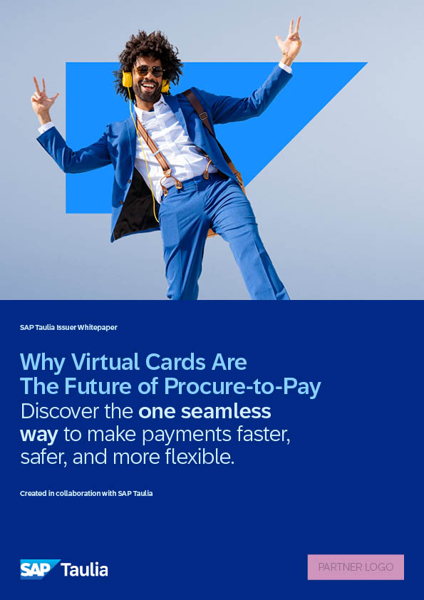




Dedicated Issuer Resources
Notes:
We also have a series of dedicated virtual card resources.
They’re designed to help support your conversations with corporates and get a better understanding of SAP Taulia’s virtual card capability.
If you’d like to find out more <contact details TBC>

Slide 10
Go One Step Further:
When to Bring in a Specialist
1
Progressing the conversation
2
Handling
objection points
3
Tackling complex questions
Notes:
So everything you’ve seen today is designed to help you showcase the benefits of virtual cards to corporates and spark initial interest.
But there are times when you might need to bring in the support of a virtual cards expert. Here are three common examples:
<Presenter prompt: Click to separately reveal the 3x on-screen examples>
1. You’ve had an initial discovery call with a corporate and want to progress the conversation
2. The corporate has objection points that you need assistance to overcome
3. The corporate requires in-depth advice to tackle specific questions (e.g., implementation timelines, required inputs, integration steps)

Slide 11

Thanks for Listening
Notes:
General wrap up and thank you

